Slide 1
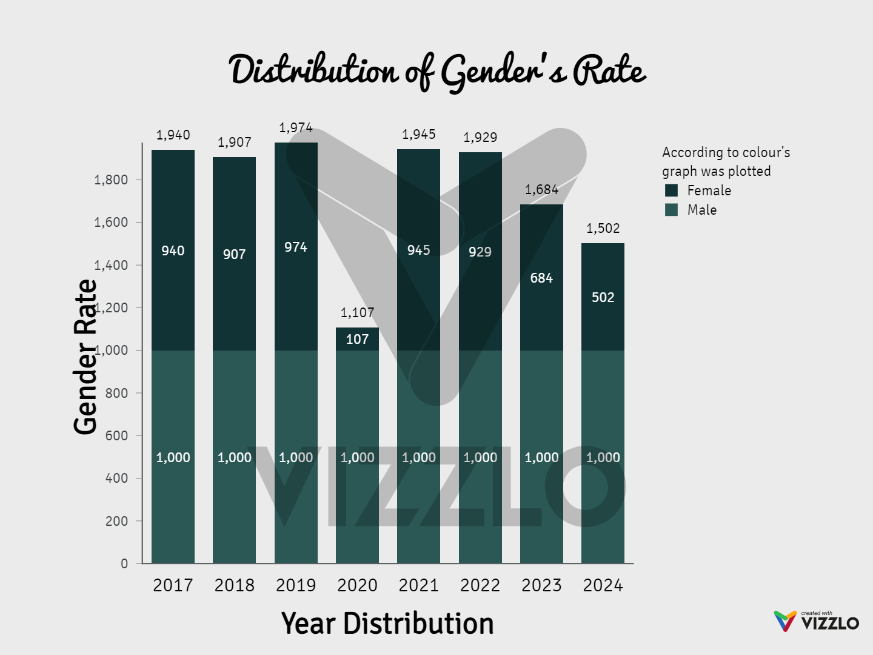
Task-01 Distribution of Gender’s ratio in a Population

Slide 2
Description:
The graph titled "Distribution of Gender's Rate" offers a detailed visualization of gender distribution from 2017 to 2024. The vertical axis(y-axis) denotes the "Gender Rate," while the horizontal axis(x-axis) specifies the "Year Distribution.“
Gender Rate Segmentation:
The bars are bifurcated into two distinct segments:
Female (depicted in light green)
Male (illustrated in dark green)
Trend Insights:
The Female rate is a constant at 1,000 across the years.
The Male rate exhibits variability, with a zenith in 2020 at 1,107, followed by a pronounced decline to 502 by 2024.
Correspondingly, the total Gender Rate mirrors this downward trend post-2020.

Slide 3
This graph serves as a cogent representation of the shifting gender rates over the specified period, emphasizing significant trends and fluctuations in gender distribution. Taking above graph as our references and we concluding that the men’s ratio remains constant and female ratio was fluctuating in each and every respective year.

